Slide 1
Matrix Factor Analysis
Experiment Results

Slide 2
Model
Two views X and Y, represented by columns of feature vectors, are involved.
Estimate the expectation of WZ^{T}, where W and Z are normalized so that each feature vector has the 1-norm of 1. Denoted as E.
Find out matrices P (p x s), A (s x t), and Q (q x t) such that
E approx. = P A Q’
Where p and q denotes the length of features selected in X and Y; s and t are given as the number of probable topics.
For each row in P and Q, the sum has to be 1; for A, the total sum should be 1.

Slide 3
Model
Calculate the matrices alternatively:
Fix A, P and solve for Q;
Fix P, Q and solve for A;
Fix A, Q and solve for P;
The initial condition:
P and Q are set to clustering centers given by k-means.
A is a random matrix or a diagonal matrix (when s = t).

Slide 4
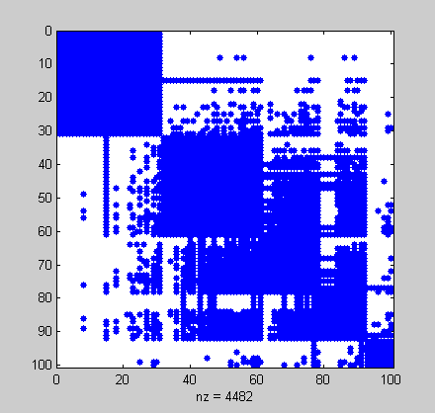
Correlation Matrix
Recall that E_{ij} = E[p(x_{i}, y_{j})]
Here y_{j} = x_{j}
So: E_{ij} = p(x_{i}, x_{j})

Slide 5
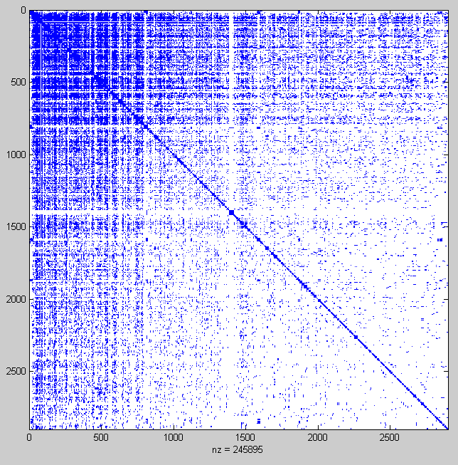
Correlation Matrix
A larger example. 2900 words.
Explanation: Our dictionary is ordered by the word’s first occurrence.

Slide 6
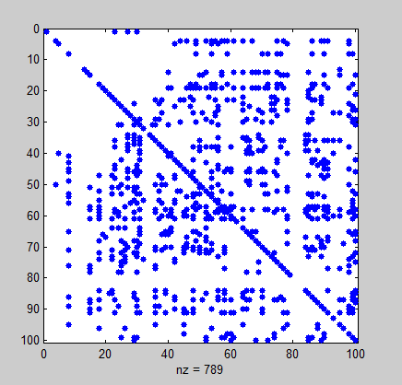
Different meanings of A
When P = Q, we actually have only one view involved.
We may do feature selection in this way. (this requires #topics = #words and appropriate initial values)

Slide 7
Feature (Word) Selection
A_{i} ≤ 0.0001：
监管 人民币 放款 非贸易 汇兑
信托业 外币 见证 存款 贴现
000004 000007 000008 基地 计算机网
禽畜 生产 000017 运动 000001
汇款 借款 结算 技术 经营
销售 资信 票据 产品
但是这个分解的误差很大（>47）

